Slide 1

It ain’t what you teach…
…it’s what they learn that counts
Learning Strategy Training
by Rachael Harris
https://fabenglish-ideas.com

Slide 2
Why?
Saves time in the long run
More efficient
Motivating
Exponential progress
Learning as we go along

Slide 3
You Can Do It
I’ve run 5 marathons
I’ve been paragliding
I’ve seen sharks when diving
I’ve travelled around France in a campervan
I’ve obtained an MA through distance learning

Slide 4
SMART or SMARTER
Specific
Measurable
Achievable
Relevant
Time-bound
Exciting
Risky
(Don’t forget the WHY!)

Slide 5
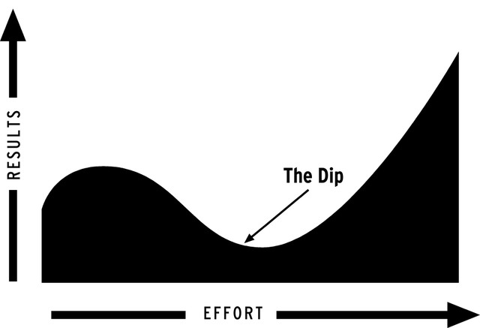
The Dip

Slide 6
Surviving the Dip
Write down your WHY
Contact the Team
Get in some quick wins
Write in your learning journal

Slide 7
QUICK WINS
10 minutes on a learning app
Watch a song on youtube with the words
Text a friend in L2
Find a copy a motivating quote in L2
Post or comment on SM in L2
Plan a reward
Find a new word in dictionary and use it today
Write in your learning journal

Slide 8
LEARNING JOURNALS
How did my learning feel today?
Something I’ve learnt…
Something I’d like to learn…
Next time I’ll…
My next step…
My next reward…
Remembering my SMARTER Goal…
Remembering my WHY…

Slide 9
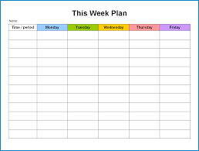
Routine: What gets planned gets done

Slide 10
Skills Strategies
Start Up Protocols
Speak aloud
Important questions

Slide 11
To Go further
Essential Motivation in The Classroom- Ian Gilbert
Motivation, Mlanguage Identity & the L2 self- Zoltàn Dörnyei & Ema Ushoida
The Dip- Seth Godin
https://fullfocusstore.com

Slide 12
Problem Solving Steps
Identify a problem
Brainstorm as many solutions as possible
Choose one
Try it for a week
Review at next class meeting
Evaluate & choose another one if necessary

Slide 13
Thank you!
ipsensig@iatefl.org
Fabenglishteacher@gmail.com

