Slide 1

The new baccalaureate
What has changed?
What is the common core?
LLCE? AMC?
The Grand Oral?
How can we support our learners studying for the French baccalaureate?
https://ipsen.iatefl.org

Slide 2
Which Bac?
Bac Générale
Bac Technique
Bac Professionel

Slide 3
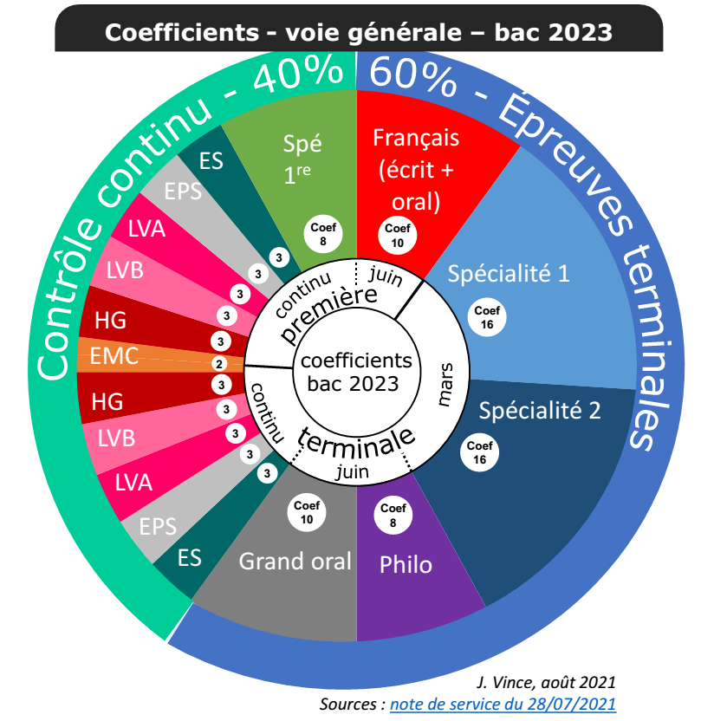
An Overview

Slide 4
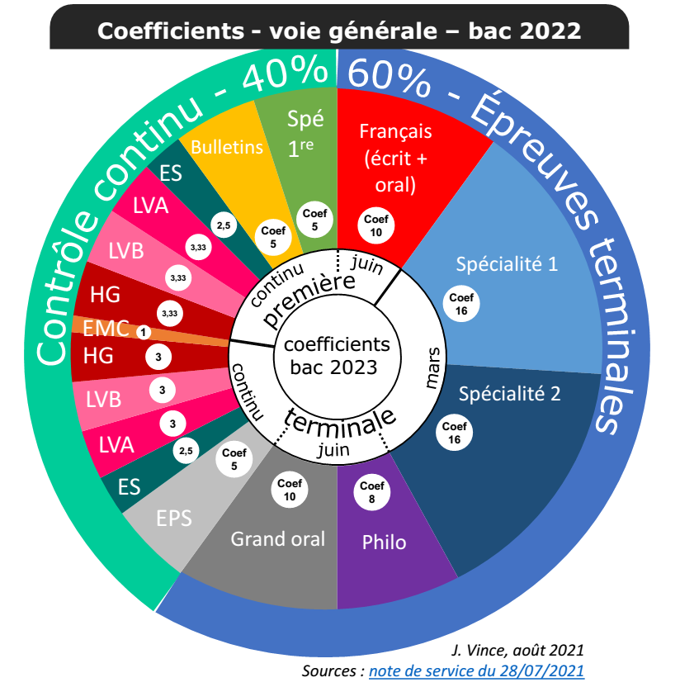

Slide 5

LVA & LVB
Continual assessment of 5 skills
Aiming for level B2, B1 ( or B1 for LVC)

Slide 6
Gestes Fondateurs et Mondes en Mouvement
1. Identities & Exchanges
-globalisation, border controls, travel & tourism, US arms laws, Tea as British identity
2. Private and Public Space
-equality, WFH, religious spaces, work-life balance in world of work today
3. Art and Power
Role of cinema, art, music in political combat, US artists & the Great depression, Art & the British monarchy
4. Citizenship and Virtual Worlds
-digital development, data sharing and protection, fake news, social media, AI, wikis, cyber-bullying, online activism, digital media as a vector for democracy

Slide 7
5. Fictions & Realities
-storytelling, imaginary worlds, historical figures in fiction, sci-fi, legends, dystopias
6. Scientific Innovations and Responsibilities
-ethics, genetic research, vaccinations, cloning,
GM food, is space conquest a dream or a necessity?
7. Diversity and Inclusion
-minorities, integration, discrimination, segregation in USA, discrimination and LGBTQ+ minorities, #BLM
8. Territory & Memory
-collective heritage, memorials, monuments, amnesties, slavery

Slide 8
“Spé anglais”
2 versions: LLCE(R) or LLCE(R) - AMC
In premier:
Spé C = continual assessment, i.e. year’s results count coef 5
2) In terminal:
A 3hour 30 written exam ( analyse & synthesis of three documents /16 plus short translation /4 – coef 8
Oral exam- student speaks for 10 minutes, answering a question of their choosing using 4-6 documents, and is then questioned by the jury on their speech and the rest of the programme – coef 8

Slide 9
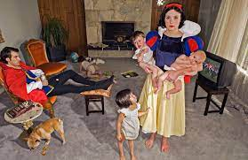
Thème1: Imaginaires
Axe 1: L’imagination créatrice et visionnaire
Fairy tales, Alice in Wonderland, Midsummer Night’s dream, science fiction: Asimov, 2001 Space Odyssey, Interstellar, game of Thrones

Slide 10
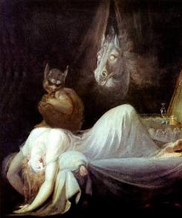
Axe 2: Imaginations effrayants
Gothic; Frankenstein, Dracula, Dr Jekyll & Mr Hyde, The Shining, Transhumanism; Gattaca, Iron Man

Slide 11
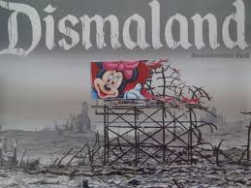
Axe 3: Utopies et dystopies
Thomas More-Utopia, Brave New World, 1984, Gattaca, Fahrenheit 451, The Handmaid’s Tale, Broadacre, Brook farm, Ecotopia

Slide 12
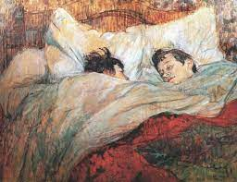
Thème2: Rencontres
Axe 1: L’amour et l’amitié
Much ado about Nothing, She walks in beauty, Austin, Thelma and Louise, Green Book, Lord of the Rings, La-La land

Slide 13
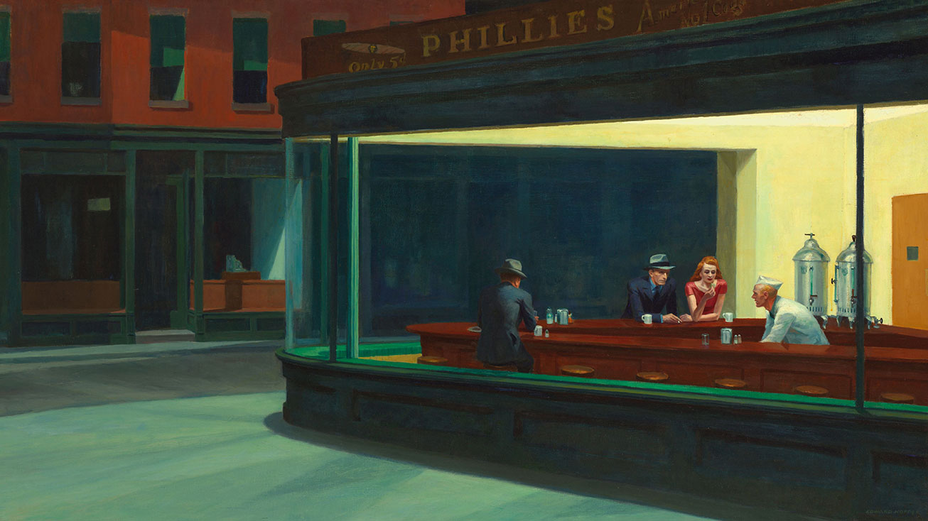
Axe 2: Relation entre l’individu et le groupe
Of Mice and Men, E.M. Forster, Indigenous Rights, War poetry and art, USA-Vietnam & the aftermath

Slide 14

Axe 3: Confrontation et Différence
#BLM, Windrush generation, Lord of the Flies, to Kill a Mockingbird

Slide 15
Plus min. 3 of the following to be studied (at least 2 books)
HADDON Mark, The Curious Incident of the Dog in the Night-Time, 2003.
LEE Harper, To Kill a Mockingbird, 1960.
ORWELL George, Animal Farm, 1945.
POE Edgar Allan, “The Fall of the House of Usher” (1839) + “The Tell-Tale Heart” (1843).
STEINBECK John, Of Mice and Men, 1937.
WILDE Oscar, The Importance of Being Earnest, 1895.
Nolan Christopher, Interstellar, 2014 ;
Wise Robert, West Side Story, 1961

Slide 16
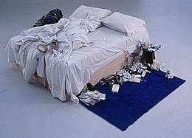
Terminal Thème 1: Arts et débats d’Idées
- Axe 1: Art et Contestation
Social protest songs, Dickens, Steinbeck, Norman Rockwell, Ken Loach, Mike Leigh
Axe 2: L’art qui fait débat
William Turner, pop art, Damien Hirst, The Catcher in the Rye, Banksy
Axe 3: l’art du débat
MLK, JFK, Churchill, Obama, My Fair lady, The King’s speech

Slide 17
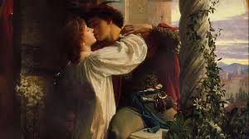
Thème 2: Expression et construction de soi
Axe 1: Expression des emotions
Wuthering Heights, stiff upper lip, 4 weddings and a funeral, Hamlet’s soliloquys, Emily Dickenson
Axe 2: Mise en scene de soi
Autoportraits, autobiographies, Star Spangled banner & Rule Britannia
Axe 3: Initiation, Apprentisage
The Bildungsroman, Oliver Twist, Matilda,
The Catcher in the Rye, Road movies,
mentor movies – Million dollar baby

Slide 18
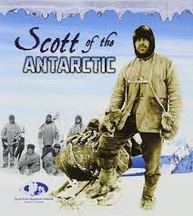
Thème 3:Voyages, territoires, frontiers
Axe 1: Exploration et aventure
David Livingstone, Mary Kingsley, Lewis & Clark, Kipling, Joseph Conrad, R.L.Stevenson, Scott, Shackleton, The Space Race
Axe 2: Ancrage et héritages
Highland games, National Trust, aborigine art and literature, New York of Paul Auster, Southern USA of Flannery O’Conner, Dublin of James Joyce
Axe 3: Migration et Exil
Amercian Dream, Salman Rushdie, Zadie Smith, Amy Tan,
the Trail of Tears, Grapes of Wrath, Ellis Island

Slide 19
Plus 3 of the followingto be studied (at least 2 books):
Atwood Margaret, The Handmaid's Tale (1985) ;
Auster Paul, Moon Palace (1989) ;
Brontë Charlotte, Jane Eyre (1847) ;
Kureishi Hanif, The Buddha of Suburbia (1990) ;
Miller Arthur, Death of a Salesman (1949) ;
Roy Arundhati, The God of Small Things (1997).
Branagh Kenneth, Much Ado About Nothing (1993) ;
Ford John, The Searchers (1956) ;
Lumet Sidney, 12 Angry Men (1957).

Slide 20
AMC Premier
Thème 1: Savoirs, Création & Innovation
Axe 1: Production & circulation des Savoirs
UK education system, Wikis, the future of education & online learning
Axe 2: Sciences é techniques, promesses et défis
AI, designer babies, Robots, GM food, Transhumanism
Thème 2: Représentations
Axe 1: Faire entendre sa voix: représentation et participation
-US elections, Brexit
Axe 2: Informer et s’informer
Social media, talk shows, investigative journalism, wikileaks
Axe 3: Représenter le monde et se representer
The Commonwealth, global cities- NY, London

Slide 21
AMC Terminal
Thème 1: Faire Societé
Axe 1: Unité et Pluralité
Religion in USA, Integration – Salad Bowls & Melting Pots
Axe 2: Libertés Publiques et Libertés Privés
Independence movements (Scotland etc), Hong Kong
Axe 3: Égalités et Inégalités
Fast fashion, on screen representation of minorities, #BLM
Thème 2: Environments en Mutation
Axe 1: Frontière et Espace
Megacities, Space race, borders- US –Mexico, UK- Northern Ireland
Axe 2: De la protection de la nature à la transition écologique
Veganism, ecotourism
Axe 3: Repenser la Ville
Transport, policing the city, eco-towns
Thème 3: Relation au Monde
Axe 1: Puissance & Influence
Policing the seas, role of USA as international police force
Axe 2: Rivaltités & Interdependences
The Arctic, GAFAM, semi-conductor shortage
Axe 3: Heritage Commun et Diversité
Royal family, cricket

Slide 22
La Grand Oral
Prepare two subjects (one per spé or mixed)
5 minute speech to “answer” your question
What is a “problematique”?
5 minute interaction: on your speech but also on the programme
5minute discussion on your professional project

Slide 23
So what should we be doing?
Get them reading!
Studying texts
Presenting different media: vlogs, TED talks, sculpture, poetry, photos, graphs
Encouraging research & presentations – authors, films, artists, architects, in the news
Film & book reviews
Letters, blogs, vlogs, whatsapp messages
Encouraging expression of ideas and opinions
Teaching & using specific vocabulary, link words & synonyms
Use of NOTES in presentations!

Slide 24
fabenglishteacher@gmail.com
@fabenglishteach
https://fabenglish-ideas.com
https://ipsen.iatefl.org
http://agreg-ink.net/index.php?title=LLCE_au_lycée_en_anglais

